Slide 1
Python NumPy

Slide 2
Agenda
Introduction to Numpy
Introduction to Array
Creating Numpy Array
Attributes of Array
Array Methods
Indexing and Slicing
Comparison and Arithmetic Operations/Function on Array
Concatenating and Stacking Array
Splitting Array
Iterating through Arrays

Slide 3
What is NumPy?

Slide 4
What is NumPy?
A package in python which stands for ‘Number Python’
It is used for mathematical and scientific computations, which contains multi-dimensional arrays and matrices
NumPy also provides a module called ‘linalg’ which contains various functions (such as det, eig, norm) to apply linear algebra on NumPy array
NumPy array is a central structure of the NumPy library. It is an n-dimensional array object containing rows and columns

Slide 5
Installation
Open terminal program (for Mac user) or command line (for Windows) and install it using following command:
conda install numpy
Or
pip install numpy

Slide 6
Installation
Alternatively, you can install numpy in a jupyter notebook using below code:
!pip install numpy
To import use the command:
Import numpy as np

Slide 7
What is an array?

Slide 8
What is an array?
A numpy array looks similar to a list
An array is a grid of values, indexed by a tuple of positive integers
It usually contains numeric values. However it can contain string values
They work faster than lists
An array can be n-dimensional

Slide 9
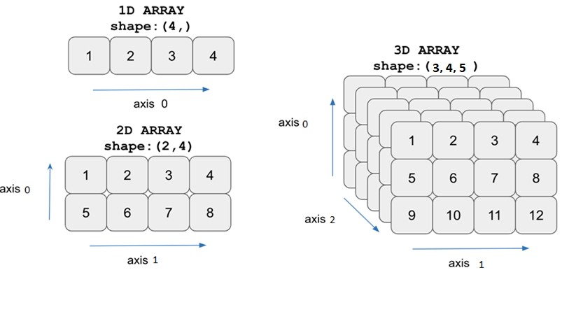
1D, 2D and 3D NumPy array

Slide 10
Creating NumPy Array

Slide 11
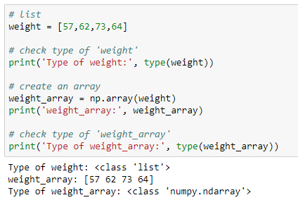
Create NumPy array using list
Use np.array() to create a numpy array from a list

Slide 12
Create NumPy array of random numbers
Create an array of 10 random numbers using random()
The random() returns random numbers from uniform distribution over the half-open interval [0.0, 1.0). The half-open interval includes 0 but excludes 1. The required number of random numbers is passed through the ‘size’ parameter

Slide 13
Create NumPy array of random numbers
The rand() creates an array of the given shape and populates it with random variables derived from a uniform distribution between (0, 1)

Slide 14
Create NumPy array of random numbers
The randn() returns a value (or a set of values) from the "Standard Normal" distribution, unlike rand() which is from a uniform distribution. A standard Normal Distribution has mean 0 and standard deviation 1

Slide 15
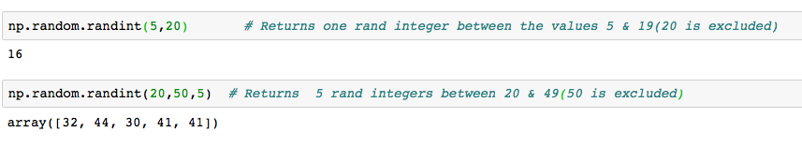
Create NumPy array of random numbers
The randint() returns random integers from low (inclusive) to high (exclusive)

Slide 16
Create NumPy array using arange()
The np.arange() creates a NumPy array
The numbers generated have the same difference
The function generates as many possible numbers in the given range
The function name
The data type (optional)
Numpy .arange (start, stop, step, dtype)
The start of the interval (optional).
Default is 0
The “step” between values (optional)
The end of the interval

Slide 17
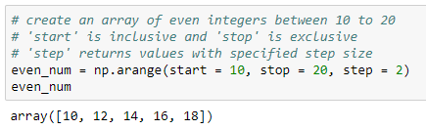
Create NumPy array using arange()
The np.arange() produces a sequence of evenly spaced values from 10 to 18 with a difference of 2, stored as an ndarray object (i.e., a NumPy array)

Slide 18
Create NumPy array using linspace()
The function generates a specified number of values in the desired range
The syntax for np.linspace() is as follows:
The function name
The data type (optional)
Numpy.linspace ( start, stop , num, dtype )
The start of the interval (optional)
The number of values required in the interval
The end of the interval

Slide 19
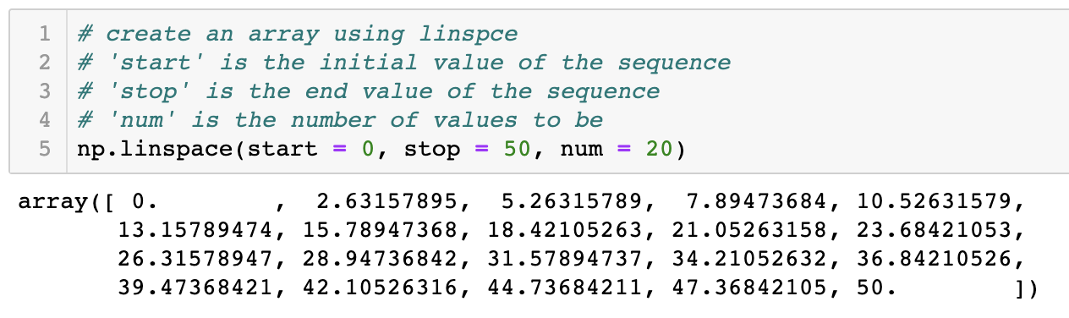
Create NumPy array using linspace()
The np.linspace() produces a sequence of 20 evenly spaced values from 0 to 50, stored as an ndarray object (i.e., a NumPy array)

Slide 20
Create NumPy array
Create 1D numpy array of zeros using np.zeros()
Create 1D numpy array of ones using np.ones()

Slide 21
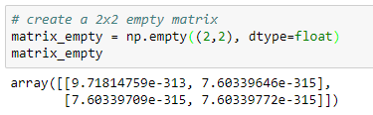
Create NumPy array
Create an empty matrix using np.empty()
It returns the matrix with arbitrary (uninitialized) values of given shape and data type
‘dtype = object’ returns None values

Slide 22
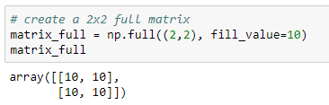
Create NumPy array
Create a full matrix using np.full()
Returns the matrix of given shape with the value passed through the ‘fill_value’ parameter

Slide 23
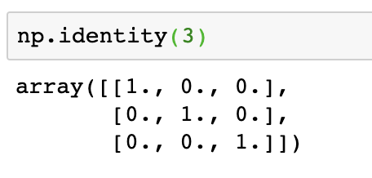
Create NumPy array
Create an identity matrix using np.identity()

Slide 24
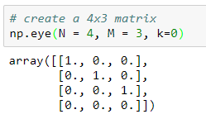
Create NumPy array
Create a matrix using np.eye()
Returns the NxM matrix with value ‘1’ on the k-th diagonal and remaining entries as zero
K = 0 represents main diagonal
K > 0 represents upper diagonal
K < 0 represents lower diagonal

Slide 25
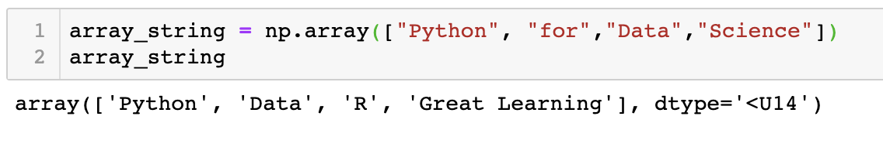
Create NumPy array
Numpy arrays can contain strings as well

Slide 26
Attributes of Array

Slide 27
Attributes of array
Attributes are the features/characteristics of an object that describes the object. Attributes do not have parentheses following them
A few attributes of the numpy array:
⚬ size
⚬ shape
⚬ ndim
⚬ dtype

Slide 28
Attributes of array
The size returns the number of elements in an array

Slide 29
Attributes of array
The shape returns the number of rows and columns of the array respectively
The ndim returns the number of axes (dimension) of the array

Slide 30
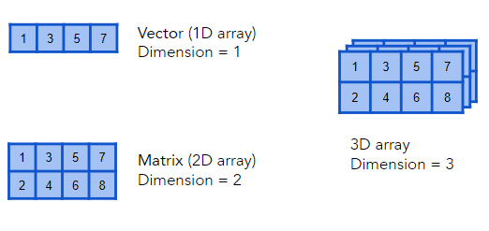
Attributes of array - ndim

Slide 31
Attributes of array
The dtype returns the type of the data along with the size in bytes
In the example, the array consists of 64-bit floating-point numbers. Thus, the dtype of the array is float64

Slide 32
Numpy Array Methods

Slide 33
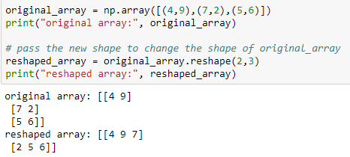
NumPy array methods
Methods are functions stored in the object’s class that takes parameters in the parentheses and returns the modified object
For example, the reshape() changes the number of rows and columns of the original array, without changing the data

Slide 34
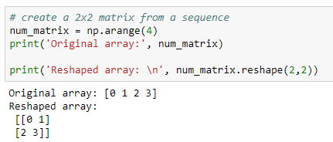
Reshape an array with reshape()
In the example, the reshape(2, 2) is reshaping a 1 X 4 array to 2 X 2 array

Slide 35
Indexing of an Array

Slide 36
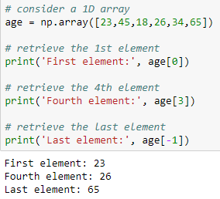
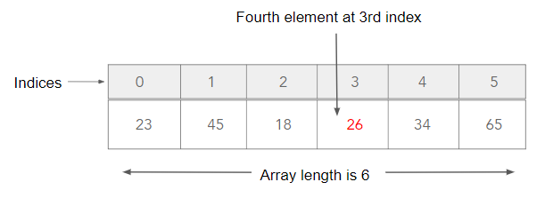
Index 1D array
Each element in the array can be accessed by passing the positional index of the element. The index for an array starts at 0 from left. It starts at -1 from the right.

Slide 37
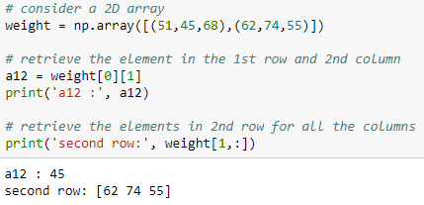
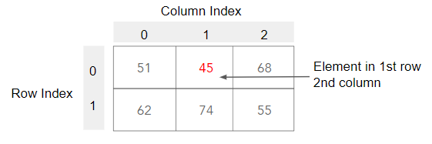
Index 2D array
Element in 2D array can be accessed by the row and column indices. We can also select a specific row or column by passing the respective index

Slide 38
Slicing of an Array

Slide 39
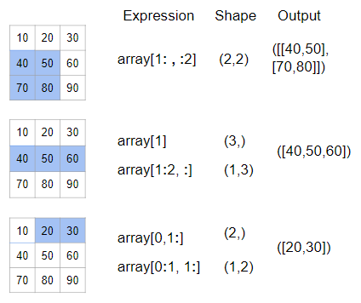
Slice arrays

Slide 40
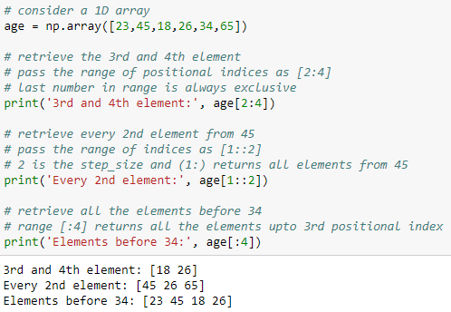
Slice 1D array
Indexing allows us to extract a single element from the array; while, slicing can be used to access more than one element

Slide 41
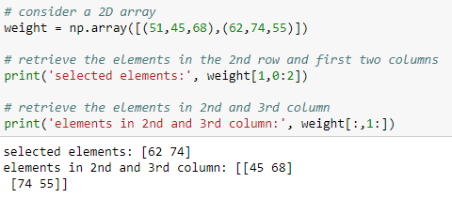
Slice 2D array
Slicing can be used to return a sub-matrix of the original matrix

Slide 42
Comparison Operations on Array

Slide 43
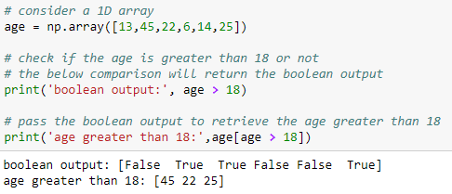
Comparison operations on array
Comparison operators can be used to validate specific condition on each element of the array. By default, the output of the comparison statement is boolean

Slide 44
Arithmetic Operations on Array

Slide 45
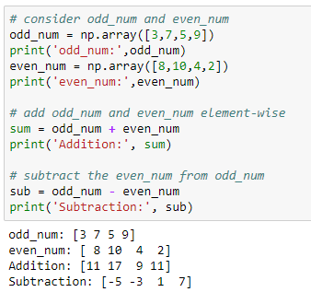
Arithmetic operations on array
Addition and Subtraction of 1D array

Slide 46
Arithmetic operations on array
Multiply each element in the array by 2

Slide 47
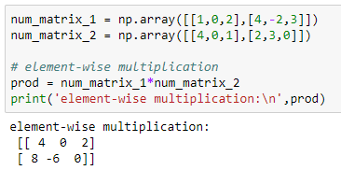
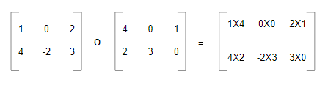
Arithmetic operations on array
Element-wise multiplication of two 3x3 matrices
m1
m2
m1 * m2
This product is also known as ‘Hadamard Product’

Slide 48
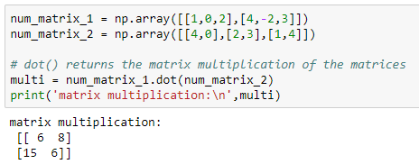
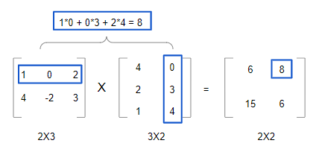
Arithmetic operations on array
Matrix multiplication of two 3x3 matrices

Slide 49
Arithmetic Functions on Array

Slide 50
Arithmetic functions on array
The min() returns the minimum value in the array
The max() returns the maximum value in the array

Slide 51
Arithmetic functions on array
The sum() returns the sum of all the elements in the array
The mean() returns the mean of the values in the array

Slide 52
Arithmetic functions on array
The var() returns the variance of all the elements in the array
The std() returns the standard deviation of all the elements in the array

Slide 53
Arithmetic functions on array
The np.square() returns the square of the elements
The np.power() is used to raise the numbers in the array to the given value

Slide 54
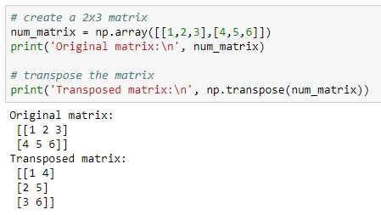
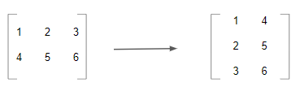
Transpose of an array
The np.transpose() permutes the dimension of an array. By default, it reverses the dimension of the array

Slide 55
Concatenate the Arrays

Slide 56
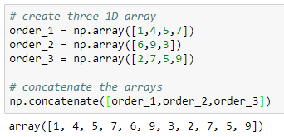
Concatenate 1D array
Two or more arrays will get joined along existing (first) axis, provided they have the same shape
Note: We can not concatenate the arrays with different dimensions (i.e. we can not concatenate a 1D array with a 2D array)

Slide 57
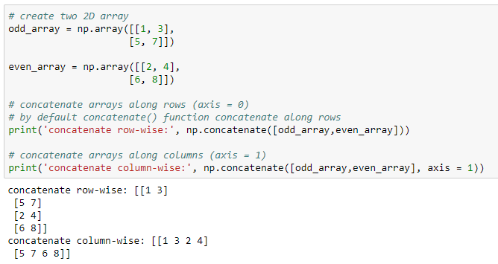
Concatenate 2D array
We can concatenate 2D arrays either along rows (axis = 0) or columns (axis = 1), provided they have same shape

Slide 58
Stacking Arrays

Slide 59
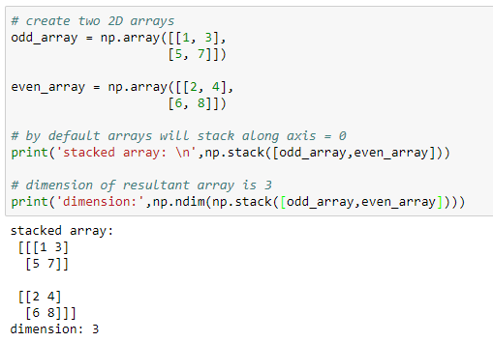
Stack arrays with stack()
The stack() is used to join two or more arrays of same shape along the specified axis. We can create higher-dimensional arrays by stacking two or more lower dimensional arrays

Slide 60
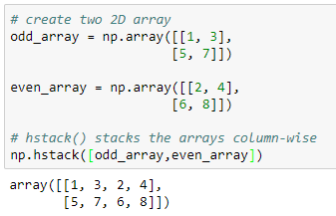
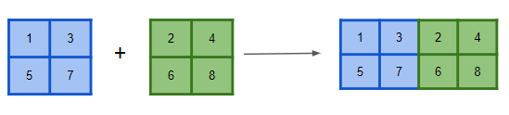
Stack arrays horizontally with hstack()
This is equivalent to concatenation along the second axis (for 2D arrays, axis = 1)

Slide 61
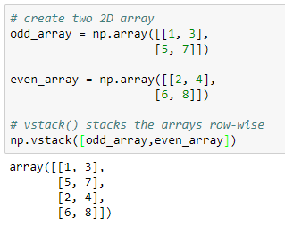
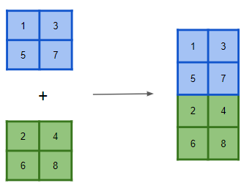
Stack arrays vertically with vstack()
This is equivalent to concatenation along the first axis (for 2D arrays, axis = 0)

Slide 62
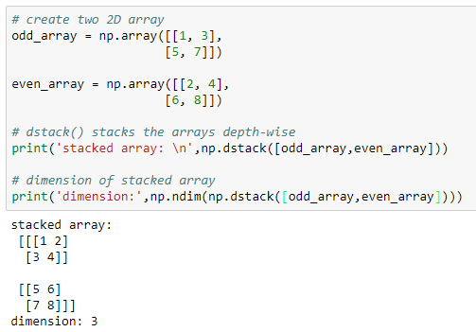
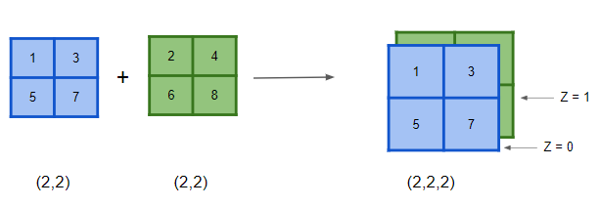
Stack arrays depth-wise using dstack()
The dstack() is used to stack the arrays depth-wise. We can create higher-dimensional arrays using dstack()

Slide 63
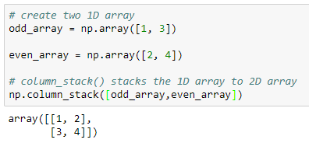

column_stack() for 1D array
The column_stack() stacks the 1D array as columns into 2D array

Slide 64
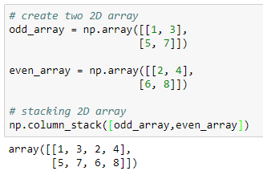
column_stack() for 2D array
For 2D arrays, column_stack() is equivalent to hstack()

Slide 65
Comparison between different stacking methods
hstack() | vstack() | dstack() | column_stack
Stacks arrays horizontally (column-wise) | Stacks arrays vertically (row-wise) | Stacks arrays depth-wise (along the 3rd axis) | Stacks 1D arrays as columns into 2D array. Stacking a 2D arrays is same as hstack()

Slide 66
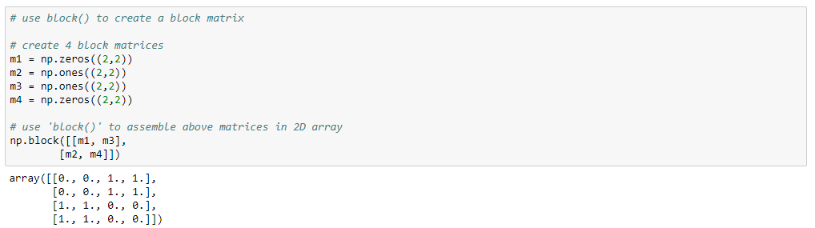
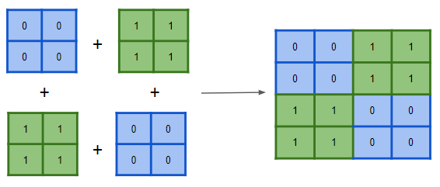
Assemble arrays using block()
The block() is used to assemble array from a nested list of blocks.

Slide 67
Splitting Arrays

Slide 68
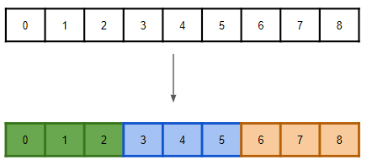
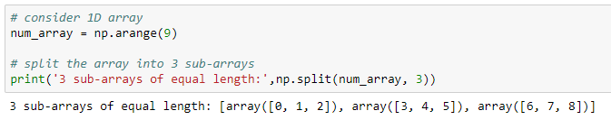
Split array with split()
The split() is used to split the array into multiple sub-arrays

Slide 69
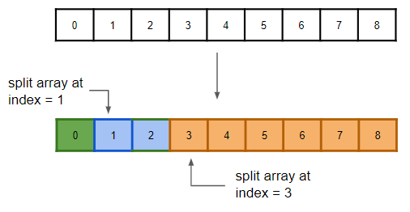
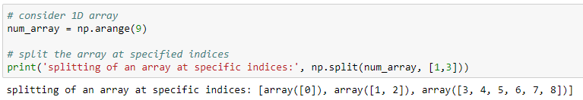
Split array with split()
split() can be used to split the array at the specific indices

Slide 70
Disadvantage of split()
The split() does not allow an integer (N) as a number of splits, if N does not divide the array into equal length of sub-arrays
i.e. If we try to split the array of nine elements into two sub-arrays, the split() throws an error; as the nine elements can not be split into two arrays of equal length

Slide 71
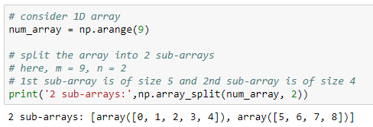
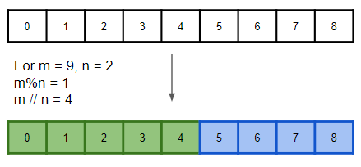
Split with array_split()
The array_split() returns multiple sub-arrays of the passed array
For an array of length ‘m’ that should be split into ‘n’ sub-arrays, array_split() returns m%n sub-arrays of size m//n + 1 and remaining of size m//n

Slide 72
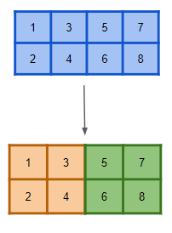
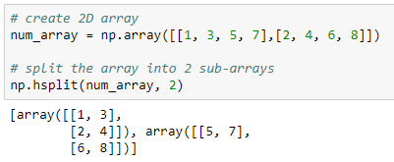
Split array horizontally with hsplit()
The hsplit() It is used to split an array horizontally (column-wise)
The hsplit() creates sub-arrays with equal number of rows

Slide 73
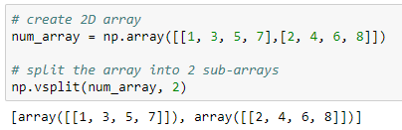

Split array vertically with vsplit()
The vsplit() is used to split an array vertically (row-wise)
The vsplit() creates sub-arrays with equal number of columns

Slide 74


Split array depth-wise with dsplit()
The dsplit() is used to split an array along the third axis (depth-wise)

Slide 75
Comparison between different splitting methods
hsplit() | vsplit() | dsplit()
Split the array horizontally. It is equivalent to split() with axis = 1 | Split the array vertically. It is equivalent to split() with axis = 0 | Split the array depth-wise. It is equivalent to split() with axis = 2

Slide 76


Flatten the array
The flatten() function collapses the original array into a single dimension

Slide 77
Iterating Arrays

Slide 78

Iterate 1D array
The for loop is used to iterate the elements in the array

Slide 79

Iterate 2D array

Slide 80

Iterate 2D array with nested loop
To print each element in the 2D array, use nested for loop

Slide 81
Thank You

